Slide 1

Live streaming of amateur sports
Business Summary
Summer 2012

Slide 2
THE PROBLEM
Amateur sports budgets are constrained by rising costs and decreasing revenues.
Expenses are rising
Transportation costs (fuel, labor)
Coaching costs (benefits, labor)
Equipment costs (driven by the increased number of sports available)
Administrative costs (total sports participants has risen for 20 consecutive years)
Revenue is decreasing
State budget cuts have impacted education financing
The difficult economy has negatively impacted philanthropic giving

Slide 3
THE CURRENT STRATEGIES
Athletic directors are currently employing multiple strategies to offset budget deficits.
Pay to Play
Students are charged fees to participate in athletics
Fundraisers
Car washes, bake sales, magazine sales
Philanthropy
Booster clubs, individual donations, etc.
Event Promotion
Emails, phone calls, social network pages promoting games
Goal is to drive additional gate receipts
Merchandising
Hats, shirts, bumper stickers containing a team logo

Slide 4
HOW TEAMZOOM HELPS
A low-cost system for broadcasting and monetizing all major school sports online.
Expand the paying fan base
Absentee fans, working parents, non-local alumni
Monetize away games when an entire conference signs on with TeamZoom
Monetize scouting video
College scouting directors are starving for high school film
Deeper fan engagement increases philanthropic giving
Out of sight, out of mind
Fundraise with a product that people want
Better sell-through rates than candy bars and magazines

Slide 5
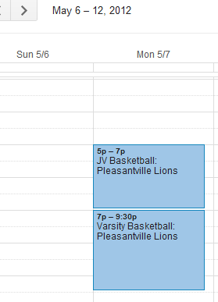

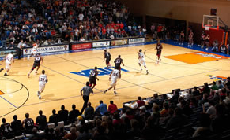

HOW DOES TEAMZOOM WORK
A self-service broadcasting platform that does not require any on-site production crew or technicians.
1. Enter the schedule(s) for all teams
2. Cameras automatically activate based on your scheduled events.
3. Games are streamed live online and archived for future viewing.

Slide 6
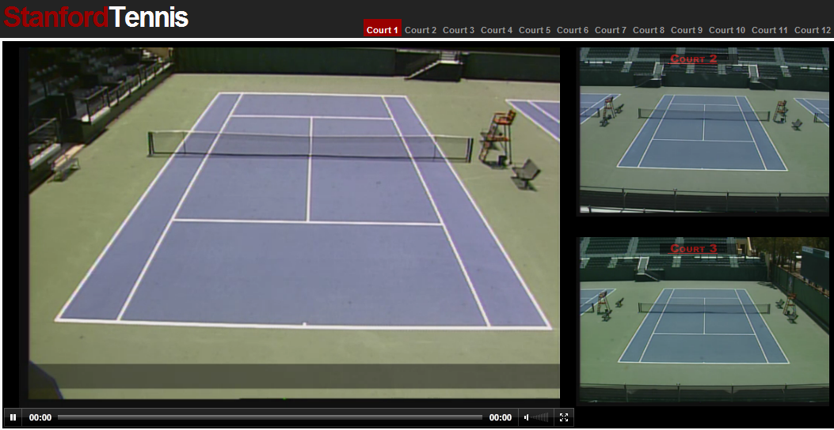
BASED ON A PROVEN PLATFORM
TeamZoom’s co-founder first developed a streaming platform for NCAA tennis. The platform is currently in use at Stanford, USC and Ohio State, and has supported more than 50,000 simultaneous viewers.
www.streamingtennis.com

Slide 7
SALES/MARKETING PROGRAM
TeamZoom will provide marketing collateral and on-site training (optional) to promote this unique fundraising program.
Turn-key fundraising program for coaches and administrators
Marketing-in-a-box provided to each school to enable a “girl scout” sales strategy.
Supplemental print / local media advertising
TeamZoom will provide marketing collateral, media files, etc. to the program manager, and encourage distribution to local media outlets as a fundraising program at the school.
Online Media
Free previews
Top plays / top players video clips distributed through social media with TeamZoom branding.

Slide 8
FINANCIAL HIGHLIGHTS
50% of program revenue is distributed to the school partner. 100 monthly subscribers (across all in-season sports) would generate $20,250 per year for a school.
Monthly subscriptions
$50 / month provides access to all in-season sports
Single Game Purchases
Single game - $8.99
Future Product Offerings
Advanced statistical services
Condensed scouting videos (organized by possession for expedited viewing)
Advertising
Highlight video creation for players

